Slide 1
ROVI2 – status Pick & Place
By Imara, Ander, Anders and Michelangelo

Slide 2
Agenda
Process
Algorithms
Vision
Robotics
Status
Plan

Slide 3
Process
Split the work:
Vision
Robotics
Everyone:
Calibration
Report (section worked on)

Slide 4
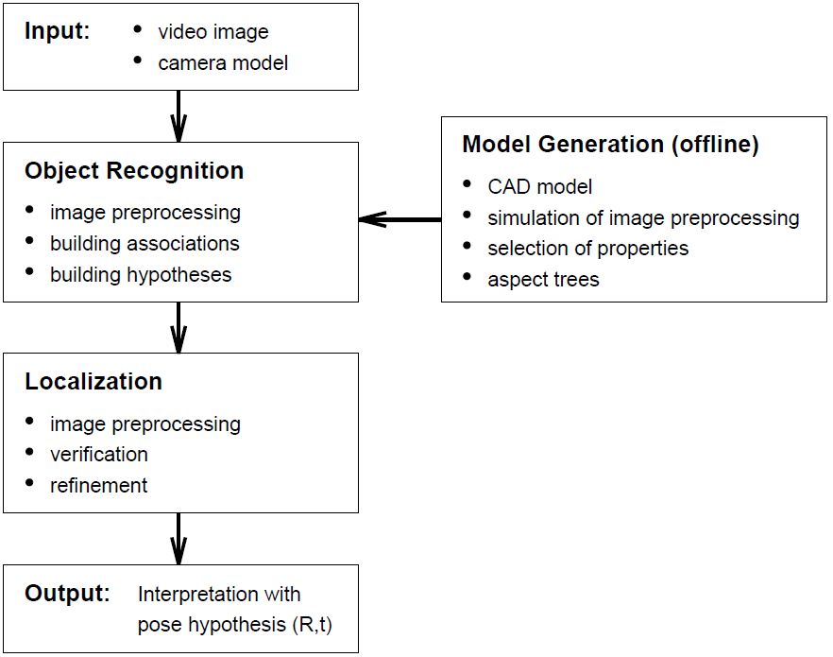
Algorithms Vision
Paper:
Robust video-based object recognition using CAD models, by Stefan Lanser, Olaf Munkelt and Christoph Zierl
After detecting object
Create point cloud
Kinect
Publish information

Slide 5
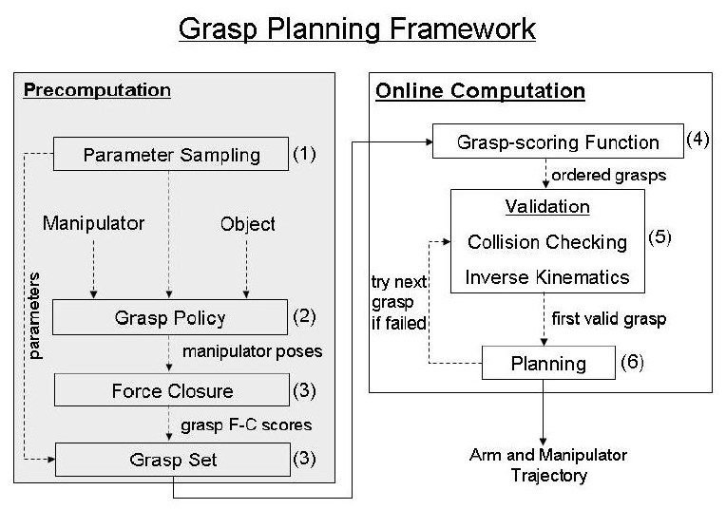
Algorithms Robotics
Motion planner:
Probabilistic roadmap planner (PRM)
Grasping:
Known objects
Paper:
Grasp planning in
complex scenes

Slide 6
Status
Overall: Focused mainly on research
Robotics:
PRM in RobWork
Vision:
Trials with edge detection on video feed
Different objects to use (brainstorm)

Slide 7
Plan
Week | To do
16 | Calibration
17 | Vision and Robotics
18 | Vision and Robotics
19 | Vision and Robotics
20 | Final testing
21 | Report – finishing
22 | Report and hand in!!!

